Slide 1
A Study on Several Face Generation Methods Using Generative Models
Sajjad Pakdamansavoji
York University
savoji@yorku.ca

Slide 2
Abstract
In this study three generative models for face generation are studied. The models include:
Deep Convolutional Generative Adversarial Network (DCGAN)
Real Valued Non-volume Preserving Normalizing Flow (realNVP)
Variational Autoencoders(VAE)
For each model, a short intro to model specification followed by the simulation results are given. To conclude our study the aforementioned models, as well as their empirical results, are compared accordingly.

Slide 3
Dataset
For this study the CelebA dataset of faces was used.
10,177 number of identities,
202,599 number of face images, and
5 landmark locations, 40 binary attributes annotations per image.
Only image faces were used in this study.

Slide 4
GAN
GANs are a series of generative models containing two main parts
Generator: creates fake faces
Discriminator: distinguishes between real and fake faces
These networks are trained in an adversarial fashion, meaning their training includes two steps. At one step the generator is trained and on the other step discriminator is trained; hence the name adversarial.

Slide 5
DCGAN
DCGAN is a special category of networks which mainly work for image generation.
These networks have convolutional layers both in discriminator and generator.
The name “adversarial” comes from the fact that generator and discriminator are trained separately according to a min-max strategy.

Slide 6
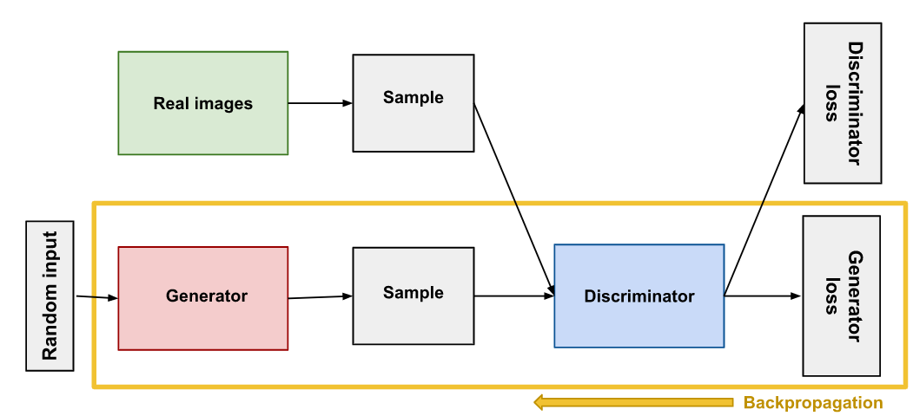
DCGAN - Training Steps
Training step for generator (discriminator is freezed)
Fig 1-a. An abstract schematic of generative adversarial networks. Image from [1]

Slide 7
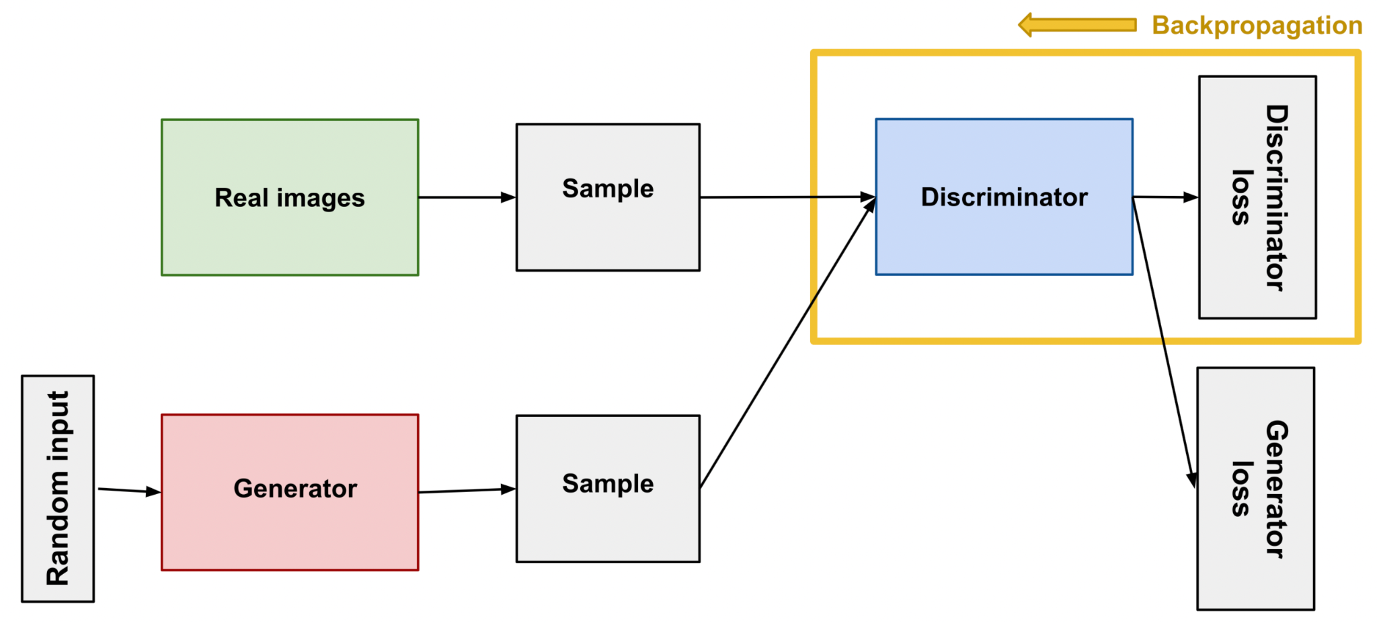
DCGAN - Training Steps
Training step for discriminator(generator is freezed)
Fig 1-b. An abstract schematic of generative adversarial networks. Image from [1]

Slide 8
DCGAN - Training Procedure
DCGAN was trained with the below specifications:
Batch size = 128
Size of latent noize = 100
Number of feature maps in generator = 64
Number of feature maps in discriminator = 64
Learning Rate = 0.0002
Optimizer= Adam(beta1 = 0.5)
Loss = Binary Cross Entropy
Num Epochs = 100

Slide 9
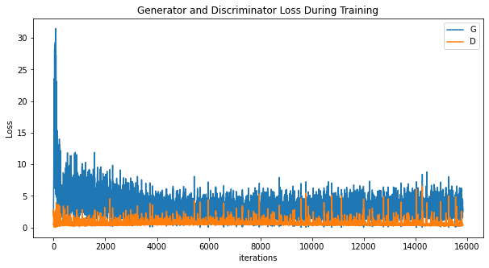
DCGAN - Empirical Results
Note how the loss fluctuates between iterations. This is because when Discriminator improves(lower D loss), Generator has higher G loss and vise versa.
Fig 2. Generator Loss and Discriminator Loss for the first 10 epochs

Slide 10

DCGAN - Faces Throughout Training
This video shows how generation of faces improves throughout the training.

Slide 11
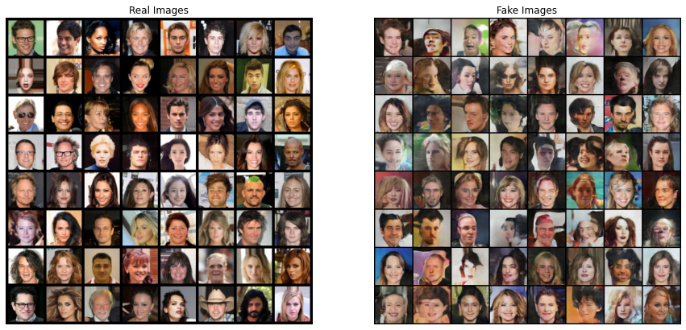
DCGAN - Real vs Fake
The quality of generated faces are comparable with the real ones.
Fig 3. Comparing real and fake faces generated by DCGAN

Slide 12
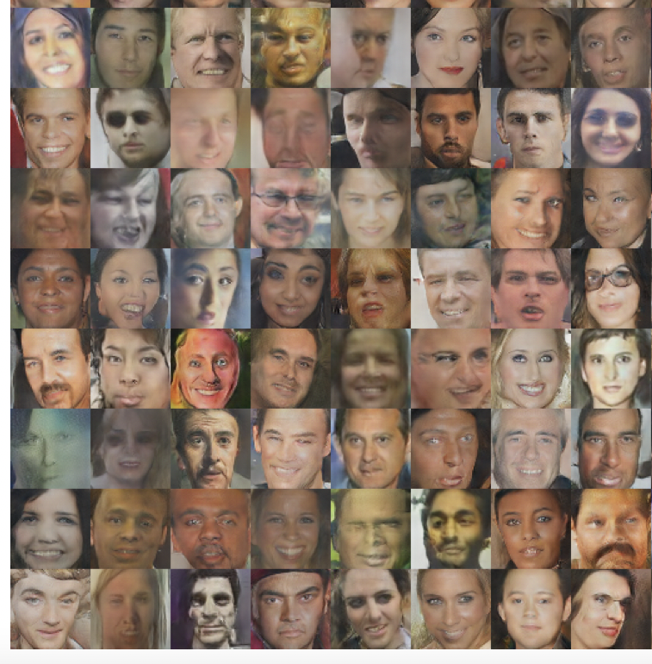
DCGAN - Results of the Original Paper
The results of our study(fig. 3) is comparable to the ones from the original paper.
Fig 4. More faces from the original DCGAN model (fig 10 in [2])

Slide 13
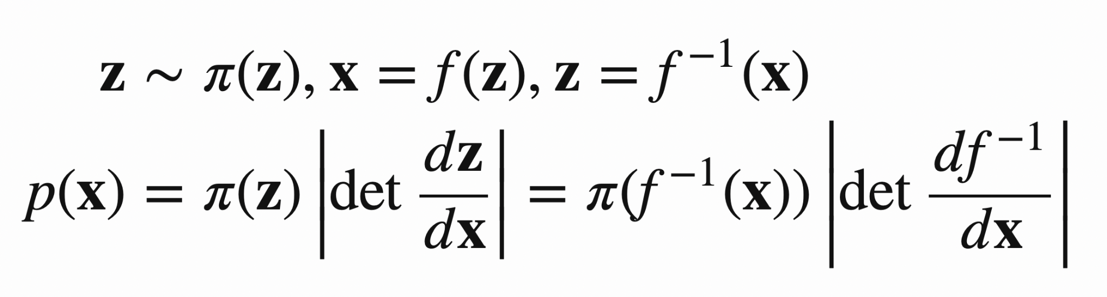
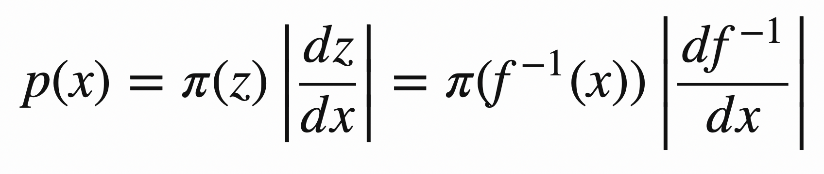
Recap: Change of Variable Theorem
Given a random variable Z~π(z) and an invertible function x = f(z),
What is the distribution of X~P(x)?
Multi var:
Single var:

Slide 14
Recap: Change of Variable Theorem
Given a random variable Z~π(z) and an invertible function x = f(z),
What is the distribution of X~P(x)?
Multi var:
Single var:
π(z)
Normalization term

Slide 15
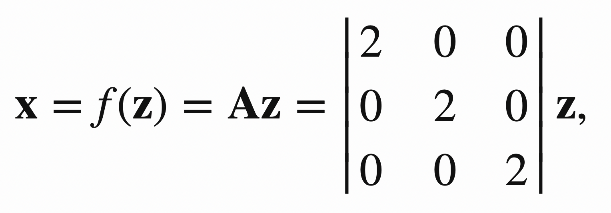
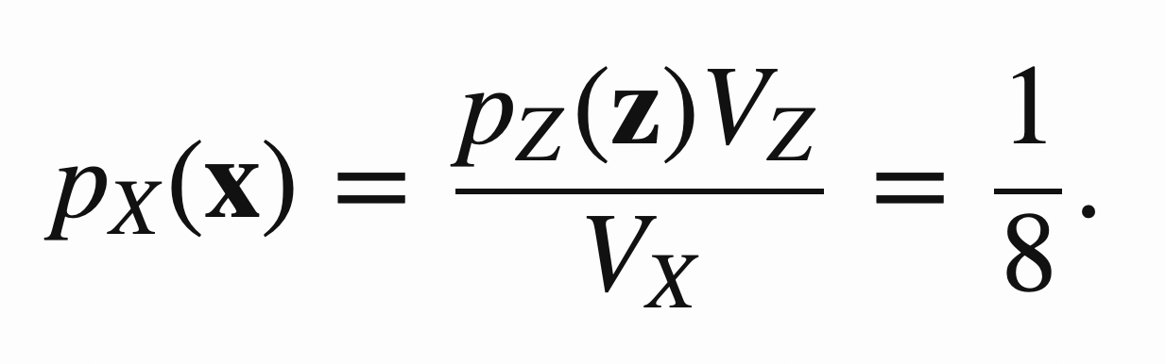
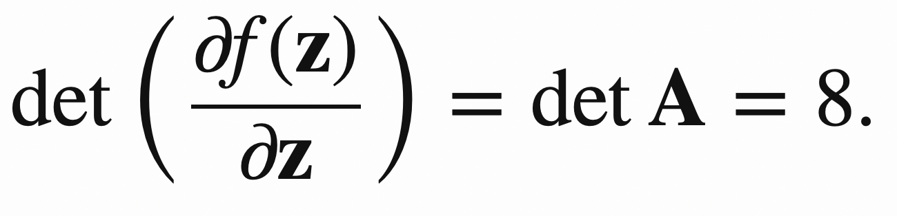
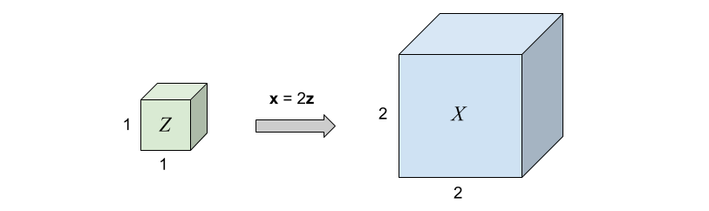
Change of Variable Intuition
Let’s start with z being uniformly distributed all over the unit cube.
Assume a simple linear transformation on z as x = Az in which A=2𝙸.

Slide 16
Change of Variable Intuition
Let’s start with z being uniformly distributed all over the unit cube.
Assume a simple linear transformation on z as x = Az in which A=2𝙸.
expansion
This phenomenon is referred to as “contraction and expansion” in the paper. [3]
contraction

Slide 17
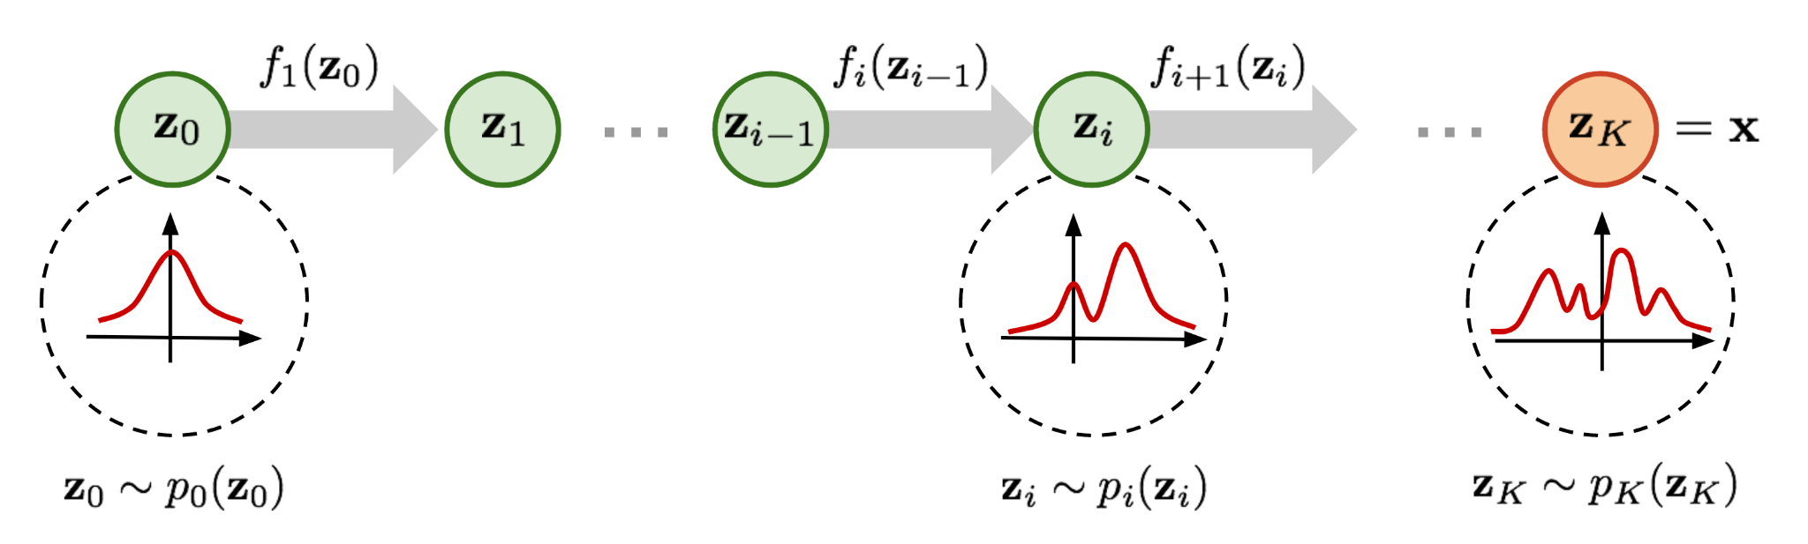
Normalizing Flow(NF)[4]
Here comes a Normalizing Flow (NF) model for better and more powerful distribution approximation.
A normalizing flow transforms a simple distribution into a complex one by applying a sequence of invertible transformation functions. Flowing through a chain of transformations, we repeatedly substitute the variable for the new one according to the change of variables theorem and eventually obtain a probability distribution of the final target variable.

Slide 18
Normalizing Flow(NF)
Here comes a Normalizing Flow (NF) model for better and more powerful distribution approximation.
A normalizing flow transforms a simple distribution into a complex one by applying a sequence of invertible transformation functions. Flowing through a chain of transformations, we repeatedly substitute the variable for the new one according to the change of variables theorem and eventually obtain a probability distribution of the final target variable.

Slide 19
Normalizing Flow(NF)
Here comes a Normalizing Flow (NF) model for better and more powerful distribution approximation.
A normalizing flow transforms a simple distribution into a complex one by applying a sequence of invertible transformation functions. Flowing through a chain of transformations, we repeatedly substitute the variable for the new one according to the change of variables theorem and eventually obtain a probability distribution of the final target variable.

Slide 20
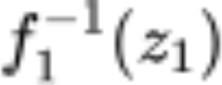
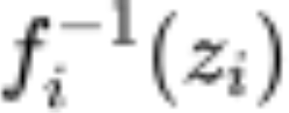
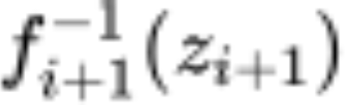
Normalizing Flow(NF)
Here comes a Normalizing Flow (NF) model for better and more powerful distribution approximation.
A normalizing flow transforms a simple distribution into a complex one by applying a sequence of invertible transformation functions. Flowing through a chain of transformations, we repeatedly substitute the variable for the new one according to the change of variables theorem and eventually obtain a probability distribution of the final target variable.
The process is invertible!

Slide 21
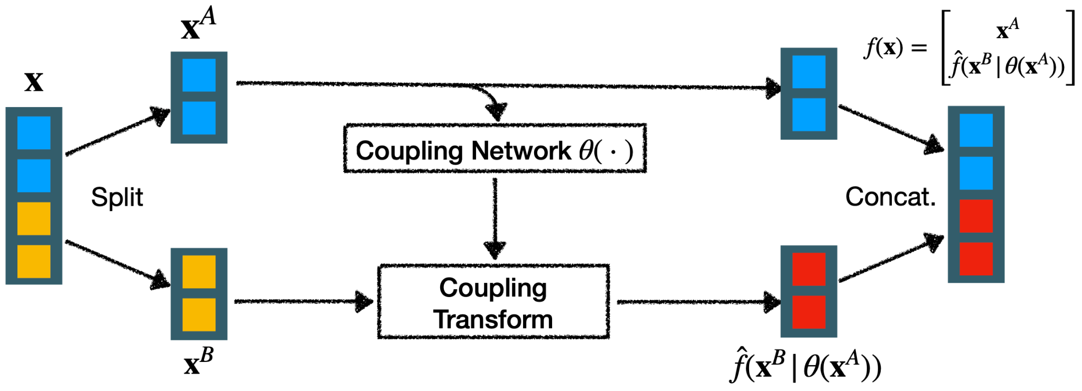
RealNVP - Coupling Layers
How to implement invertible function via neural networks? Coupling Layers are the solution.
Coupling layer is the architecture used in several NF models including NICE.[5]

Slide 22
RealNVP - Coupling Layers
Coupling layer is the architecture used in several NF models including NICE.

Slide 23
RealNVP - Coupling Layers
Coupling layer is the architecture used in several NF models including NICE.

Slide 24
RealNVP - Coupling Layers
Coupling layer is the architecture used in several NF models including NICE.

Slide 25
RealNVP - Coupling Layers
Coupling layer is the architecture used in several NF models including NICE.

Slide 26
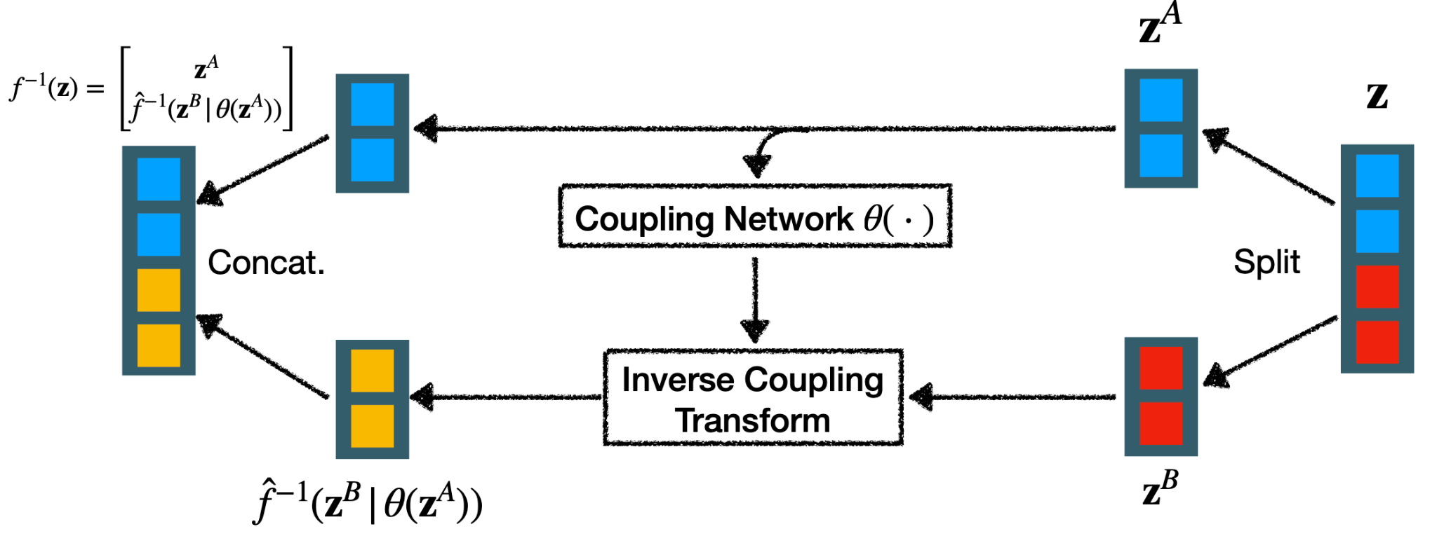
RealNVP - Coupling Layers
Given the right components(coupling network and coupling transform) the whole process can be in fact invertible.

Slide 27
RealNVP - Training Procedure
RealNVP was trained with the below specifications:
Batch size = 64
Base dimension = 32
Learning Rate = 0.001
Learning decay = 0.999
Momentum = 0.9
Optimizer= Adamax
Loss = Logit Log Probability
Num Epochs = 50

Slide 28
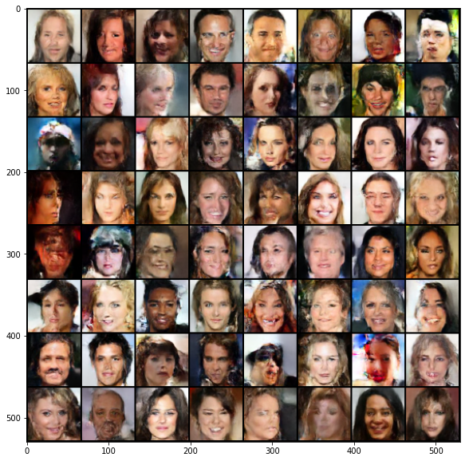
RealNVP - Empirical Results
Fig 5. Faces generated from the realNVP model

Slide 29
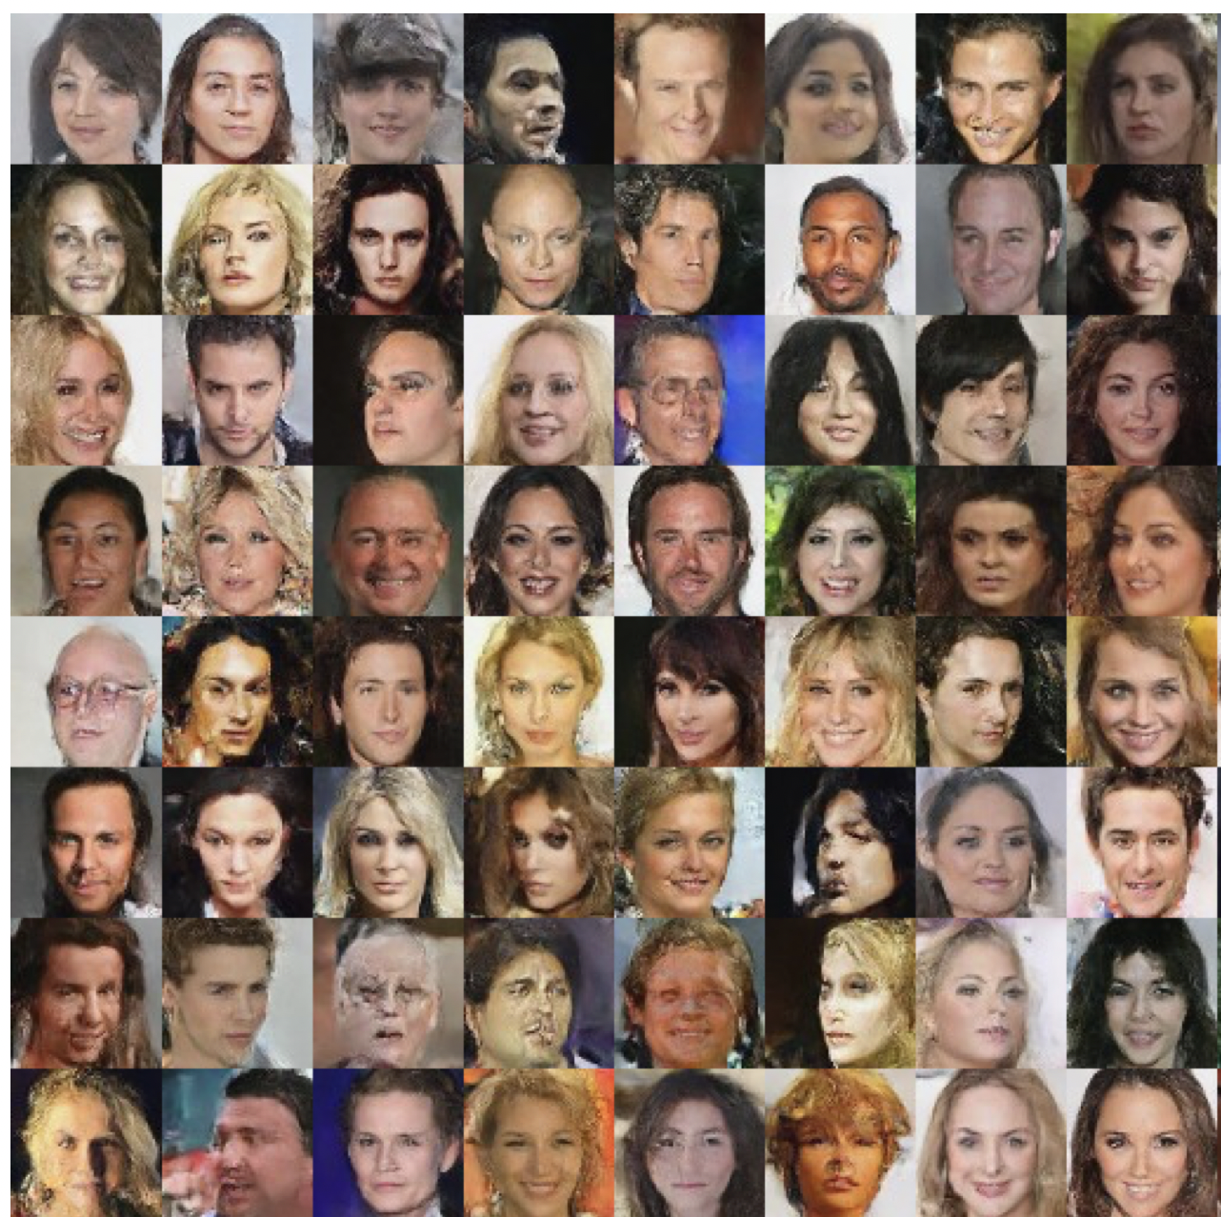
RealNVP - Results from the Original Paper
The result of this study(fig. 5) is comparable with the original paper.
Fig 6. Faces generation with realNVP

Slide 30
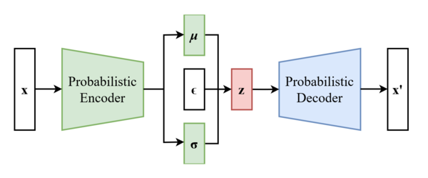
VAE
VAE is a specific example of autoencoders in which instead of finding an explicit mapping from input to latent dim and from latent dim to output, a probability distribution will be approximated.
Fig 7-a. A general diagram for variational autoencoder

Slide 31
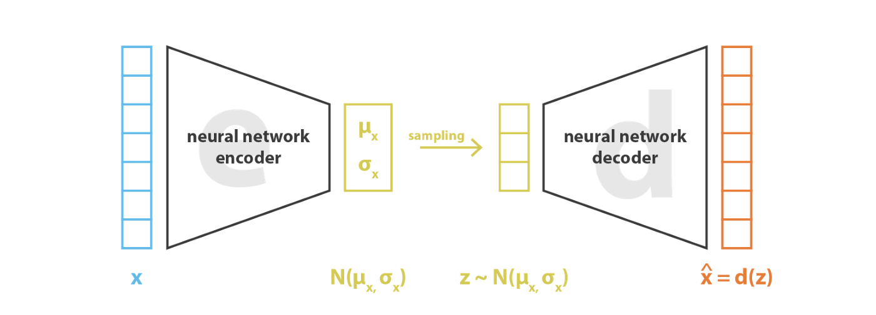
VAE - Parameterization Technique
As depicted in figure 7, in the probabilistic decoder one needs to sample from the random variable(distribution) z in a differentiable fashion as SGD will be used for training. To do that 𝝐 will be a random number and p(z) = f(𝝐).
For instance, N(𝜇, 𝜎) = 𝜎 .N(0, 1) + 𝜇 = 𝜎 .𝝐 + 𝜇
Fig 7-b. The parameterization technique for VAE[7]

Slide 32
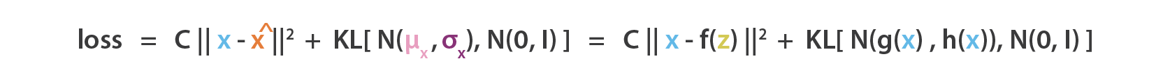
VAE - Loss Function
VAE loss function consists of two parts. One part is responsible for penalizing low quality reconstruction and the other one is responsible for rearranging the distributions in the latent variable space.

Slide 33
VAE - Training Procedure
VAE was trained with the below specifications:
Batch size = 144
Latent dimension = 128
Learning Rate = 0.005
Scheduler Gamma = 0.95
Optimizer= SGD
Loss = Log Probability + KLD
Num Epochs = 30

Slide 34
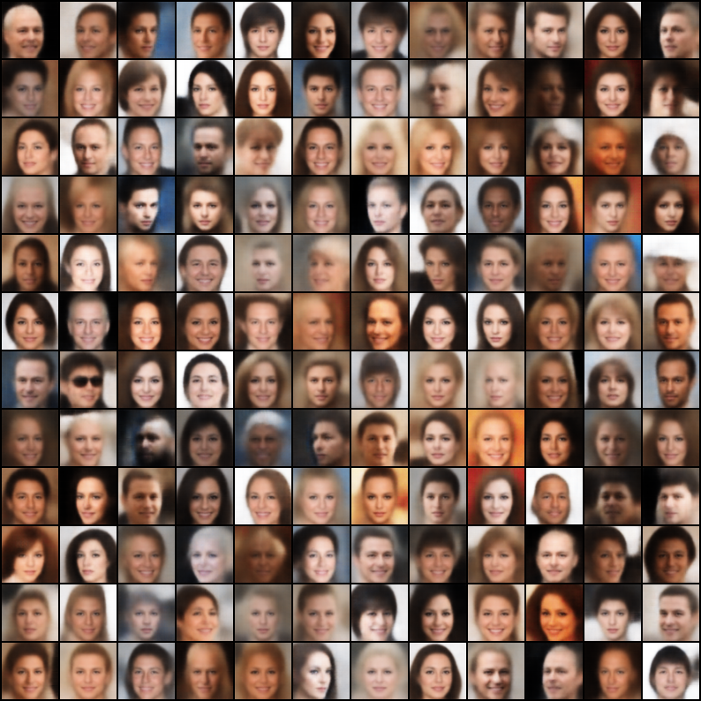
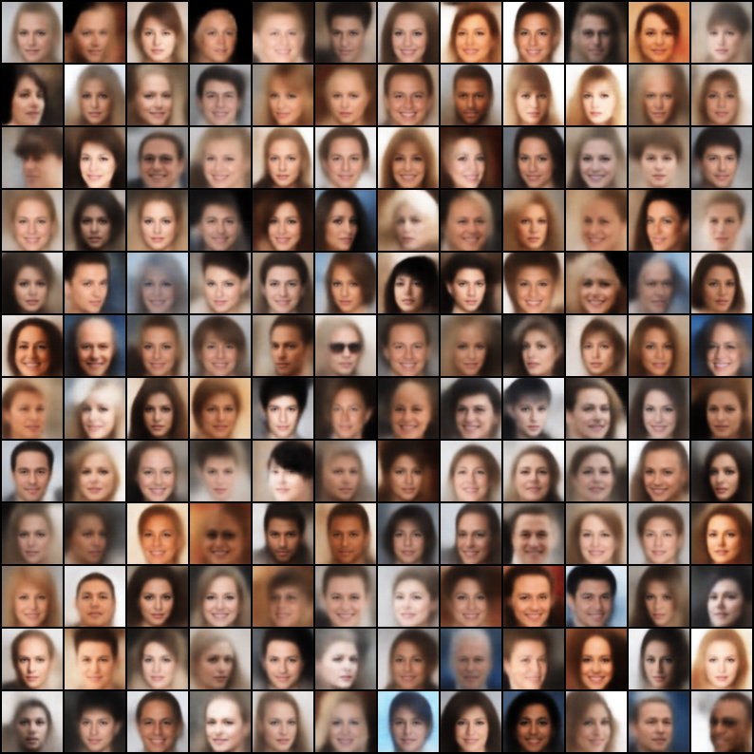
VAE - Empirical Results
The performance of reconstruction and generation is given below.
Fig 8. Reconstruction and Generation of VAE(from left to right)

Slide 35
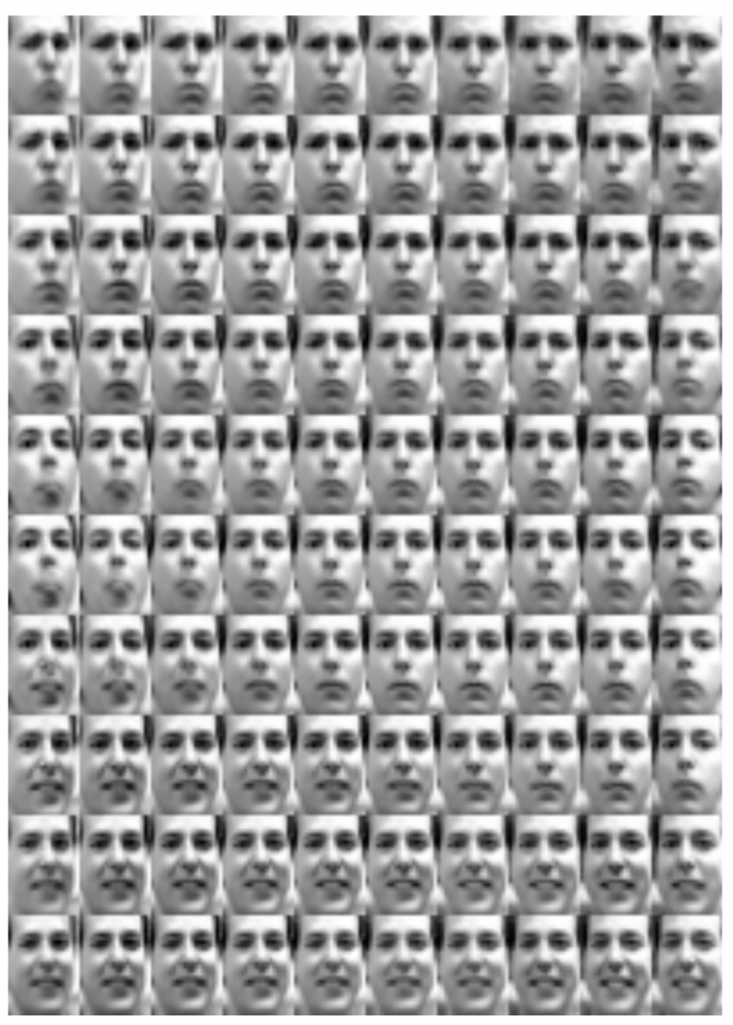
VAE - Empirical Results from Original Paper
The original paper [6] only studied frey faces manifold. It does not including any results from the CelebA dataset.
Fig 9. Frey Faces in [6]

Slide 36
Comparing DCGAN, RealNVP, and VAE
Although the quality of generated images heavily depend on the hyperparameters used in each model, in the following their performance is compared.
Fig 10. Generated faces (DCGAN, RealNVP, VAE from left to right)

Slide 37
Comparing Models - Deformation and Blur
Some examples do not really convey a real face as they are either too distorted or are too blurry.
DCGAN -> Deformed, not blurry
RealNVP -> Deformed, not blurry
VAE -> Symmetric, but blurry(*)
(*): the distribution of background is too complex so it will be blurry

Slide 38
Comparing Models - Methodology
These models use vary different methodologies for data generation.
DCGAN -> Adversarial Training
RealNVP -> Distribution Estimation with Cascaded Invertible Function
VAE -> Parameter Estimation of Specific Base Distribution(eg. gaussian)
One can Say RealNVP methodology is more complex version of that of VAE as RealNVP estimates an arbitrary distribution while VAE only estimates a family of distributions. GAN, however, follows an entirely different scheme.

Slide 39
Comparing Models - Training Stability
These models also differ in training stability.
DCGAN -> Unstable (mode collapse, adversarial nature)
RealNVP -> Fairly Stable
VAE -> Fairly Stable
As RealNVP and VAE have the similar loss, their training is stable in the conventional sense. Whereas training GANs proposes specific challenges including mode collapse.

Slide 40
Comparing Models - Convergence Speed
This comparison is based on the time consumed for training each model.
DCGAN -> Fairly Fast [0.5 min/epoch, 100 epochs = 50 mins]
RealNVP -> Almost Fast [2.0 min/epoch, 50 epochs = 100 mins]
VAE -> Relatively Slow [6.0 min/epoch, 30 epochs = 180 mins]
VAE and RealNVP converge slower as they are solving two tasks at the same time. One of them is generation and the other one is reconstruction. While DCGAN solves generation and discrimination.

Slide 41
References
[1]: https://developers.google.com/machine-learning/gan/generator
[2]: https://arxiv.org/pdf/1511.06434v2.pdf
[3]: https://paperswithcode.com/method/realnvp
[4]: https://lilianweng.github.io/lil-log/2018/10/13/flow-based-deep-generative-models.html
[5]: https://www.youtube.com/watch?v=8XufsgG066A
[6]: https://arxiv.org/pdf/1312.6114.pdf
[7]: https://towardsdatascience.com/understanding-variational-autoencoders-vaes-f70510919f73

